Slide 1
KP Erratic Tank Level Investigation
NOC: PRB -80

Slide 2
Issue Definition
What We Know
What we have solved
Analyze
Conclusions

Slide 3
Issue Definition
A number of KPs were observed to be having an inconsistent/unpredictable tank level reading profiles as dispenses occur over time.
The two major impacts of this are:
The Refill team has scheduled tasks in the past guided by erroneous readings that in some cases led to overfills and leakages.
KPs have gone out of stock due to false tank level reporting
The NOC team have lacked reliable cross-reference data when scheduling refunds for customers with under-dispense complaints.

Slide 4
What We Know
Initial investigations led to the possible causes listed below:
Live sensor sampling during the dispense process led to
Erroneous values attributed to the unpredictable pressure changes at the sensor location as fuel is dispensed.
erroneous value due to the untrue tank level sampled after a dispense is terminated due to the Canister Full error before the dispense fuel safety valve has been opened.
Hardware issues
Environmental issues
Operational issues

Slide 5
What We Have Solved
Live sensor sampling has incrementally been addressed through software improvements upto Release 35 in 2 ways below:
After every dispense (including cases where the dispense does not start due to a Canister Full error), the dispense fuel safety valve stays open for 2 seconds after the pump stops so that accurate readings of the tank level are sampled.
Tank level(TL) values reported in any heartbeat data sent mid dispense are read from the previous known TL value stored in the controller EEPROM.
The hardware and environmental causes have affected more than 50% of the network and will be the subject of the subsequent investigations.

Slide 6

Analysis
Identify and analyze possible root causes
Identify solution

Slide 7
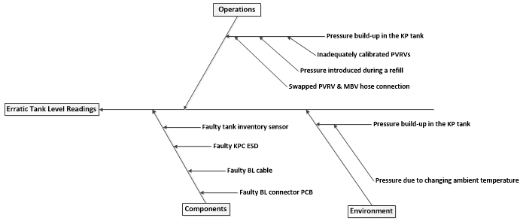
Possible Root Cause(s)

Slide 8
Findings
3 sensors (after passing internal QC during analysis) were deployed on field KPs on 5/14/2020 and have been sending accurate TL readings. Considering the erratic TL issue had persisted on the previous KPs even after tank inventory sensor replacement, this rules out sensor fault as a major cause of the erratic behavior.
The MS-BS investigation report provides findings on 6 KPs investigated for possibility of pressure being the cause of the variances in tank level readings. The conclusion from the report is that pressure build-up is indeed the major cause of the erratic readings.

Slide 9
Conclusion
The short term solution based on findings of the investigations reported has involved loosening the PVRV by the maintenance team as guided in the Suspected Pressurized KP Troubleshooting Guide which allows the PVRV to vent continuously.
223 KPs have been visited by the maintenance team and successfully addressed.
This is currently being monitored as a potential long term solution for the Nairobi network if the identified challenge of unfastening PVRVs for calibration prevails.
The long term solution for future networks should involve calibration of all PVRVs based on the procedure defined by the design engineering team.
The NOC team will be required to adjust bookstock readings to match current measured stock readings for all the KPs whose issues have been resolved using the short-term solution.

